Slide 1
Functional Programming
VIVEK KUMAR
IIT KHARAGPUR
ROLL NO-21IM10041
EMAIL-kumarvivek13025@gmail.com

Slide 2
Paradigms of Programming
Object-Oriented
Procedural
Functional
Organize data and logic in objects(properties + methods)
Write sequential series of execution steps/tasks
Organize code in (pure) functions with clearly defines tasks
Organize code in logical entities
"Top to bottom" code execution
Pass data around via parameters.

Slide 3


Some great examples where Functional Programming has been used 1.Haskell (used for spam filtering on facebook) 2.Erlang (was used at one time for building whatsapp) 3.Scala(in twitter building ,was a form of Haskell) 4.SML. These great platforms were built on the base of these functional programming languages

Slide 4
Functional Programming-Some Basic Features
1.Statically typed
2.What it means to be Purely functional
3. Type inferencing in FP
4.Languages in FP being Lazy and Concurrent.
5.How Lambdas are essential part.

Slide 5
LET'S DISCUSS THESE FEATURES IN DETAIL.

Slide 6
1.Statically typed
A statically-typed language is a language (such as Java, C, or C++) where variable types are known at compile time.
In most of these languages, types must be expressly indicated by the programmer;
in other cases (such as OCaml), type inference allows the programmer to not indicate their variable types.

Slide 7
BENEFITS OF STATICALLY –TYPED LANGUAGES
Protection from Runtime Errors
IDE Assistance
Performance Optimisation
Expressive Language Features

Slide 8
What It Is Meant To Be Purely Functional
Purely Functional programming usally represents a style of building the structure and elements of computer programs that treats all computation as the evaluation of mathematical functions.
It ensures that the functions inside the functional paradigm only depends on arguments regardless of any global or local state.

Slide 9
Properties of purely functional programmming
Parallel Computing
Data Structure –Purely functional data structures are often represented in a different way then their imperative counterparts.For example,array with constant-time access and update is a basic component of most imperative data-structures,such as hash table and binary heap,are based on arrays.

Slide 10
Type Inferencing in FP
What does Type Inference Mean?
Type inference is the automatic deduction of the data types of specific expressions in a programming language, usually done at compile time.
Type inference is often a compiler feature of functional programming languages rather than of object-oriented ones.
Benfits of Type inference
The goal of type inference is to assign a type to each expression that occurs in a program. The simplest case for type inference occurs when the compiler can assign a type to each base element in an expression—that is, to each leaf in the parse tree for an expression.

Slide 11
Lambdas as an essential part of FP
A lambda function is a small anonymous function.
A lambda function can take any number of arguments, but can only have one expression.
Why Use Lambda Functions?
The power of lambda is better shown when you use them as an anonymous function inside another function.

Slide 12
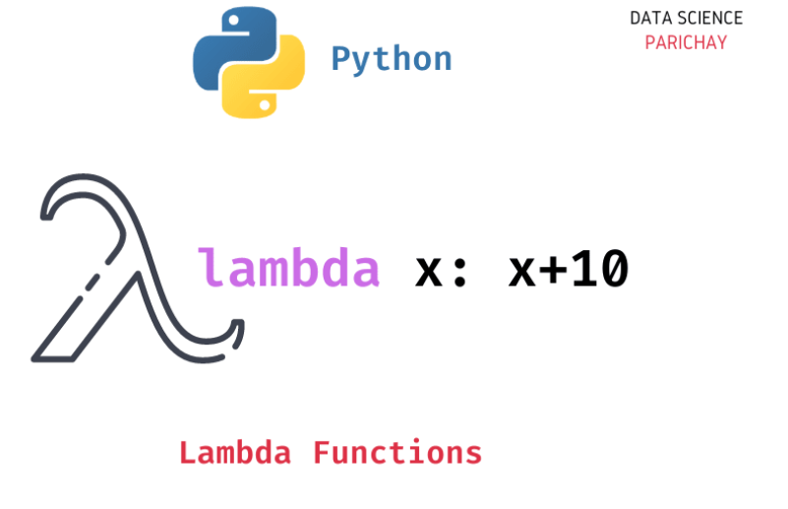
Lambda in Python
Syntax
lambda arguments : expression
Example
Add 10 to argument a, and return the result:
x = lambda a : a + 10 print(x(5))
Lambda expressions in C++
In C++11 and later, a lambda expression—often called a lambda—is a convenient way of defining an anonymous function object (a closure) right at the location where it's invoked or passed as an argument to a function

Slide 13
The ISO C++ Standard shows a simple lambda that is passed as the third argument to the std::sort() function:
#include <algorithm>
#include <cmath>
void abssort(float* x, unsigned n) {
std::sort(x, x + n,
// Lambda expression begins
[](float a, float b)
return (std::abs(a) < std::abs(b));
} // end of lambda expression
);
}
Parts of a lambda expression in C++

Slide 14
Functional programming vs OOP
Function Programming | Object-Oriented Programmig
1.Supports Parallel Programming | Not suitable for Parallel Programming
2.Flow Control is done using function calls & function calls with recursion | Flow control is done using loops and conditional statements.
3.It uses "Recursion" concept to iterate Collection Data. | It uses "Loop" concept to iterate Collection Data. For example: For-each loop in Java
4.Its functions have no-side effects | Its methods can produce serious side effects.

Slide 15
Advantages of Functional Programming
Bugs Free Code
Efficient Parellel Programming
Effeciency
Supports Nested Functions- Functional programs consist of independent units that can run concurrently. As a result, such programs are more efficient.
Lazy Evaluations-It is an evaluation strategy which delays the evaluation of an expression until its value is needed

Slide 16

Haskell –A FP Language
Why to use Haskell?
Memory safety
Garbage collection
Laziness
Concurrency
Metaprogramming
For more:https://www.haskell.org/

Slide 17
Features of Haskell
Purely Functional
Statically Typed
Type Inference
Concurrent.

Slide 18
Summary
Nowdays,OOP languages such as C++ and python have introduced Functional Progamming paradigm features .
Subtle shift in trends has occurred due to FP due to its features.
FP has allowed many programmers to associate due to its features of parellel programming thus making the work very easy and less hectic.
History shows tha FP has always been a prior focus to the programmers and to those who had built some very successful websites.

